Slide 1
Playwright Automated Testing Tool
Presented by
Saurav Tuladhar

Slide 2
Introduction
Open-source platform developed by Microsoft.
Developed by Microsoft, Playwright is a Node. js library that automates Chromium, Firefox, and WebKit
Playwright Test was created specifically to accommodate the needs of end-to-end testing

Slide 3
Pros and Cons
It supports multi-tab, multi-user, and iframe
supports different types of testing, such as end-to-end, functional, and API testing.
Generate an HTML report to view the results of the test run in the browser.
Auto-waiting of elements
GUI Interface
Attachments for test runs
Does not support Microsoft Edge or earlier IE11.
Uses a desktop browser instead of a real device to emulate a mobile device
APIRequest method does not support disabling tracking redirects.
Сonfusing documentation
Smaller community

Slide 4
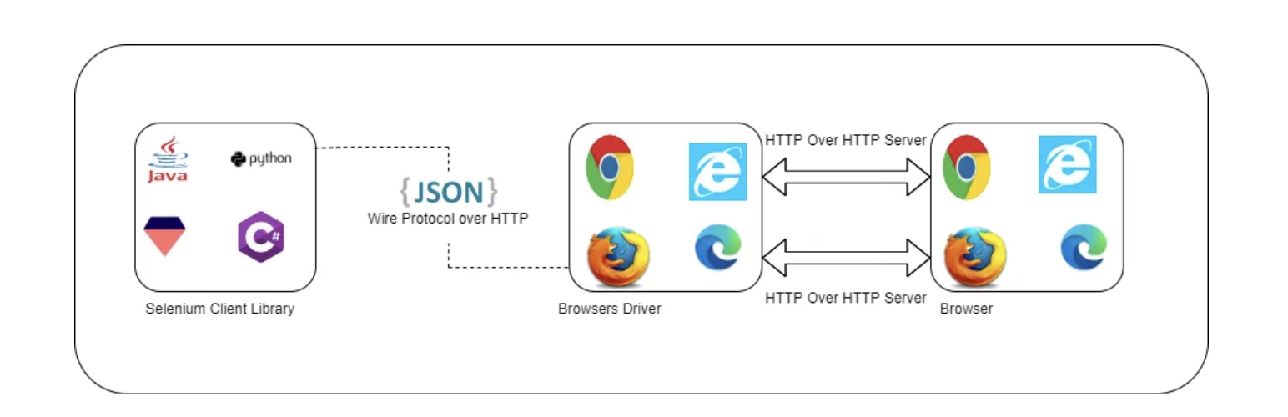
Architecture Comparison
Selenium works on the HTTP connection protocol. It means after you trigger the test, the complete Selenium code written by us (Client) will be converted to JSON format. Generated JSON is sent to the browser driver (Server) through HTTP protocol.

Slide 5
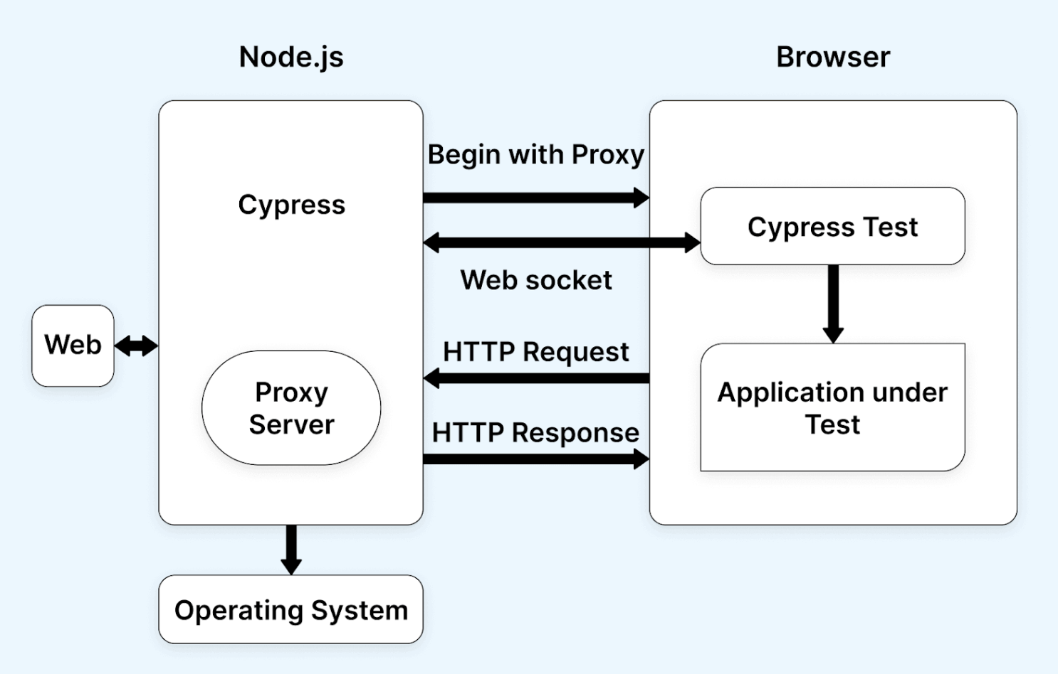
Architecture Comparison
Cypress operates with a Node server, establishing constant communication, synchronization, and task execution between the entities. In Cypress, all commands are executed directly within the browser, eliminating the need for driver binaries and streamlining the testing process.

Slide 6
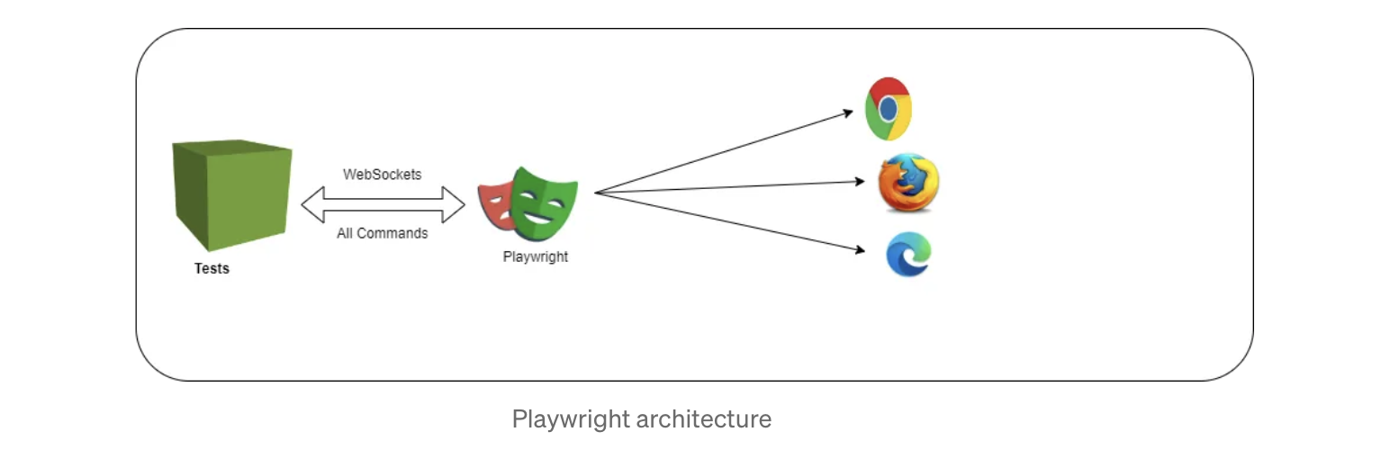
Architecture Comparison contd..
While Playwright works on Web socket connection protocol, it means once you will trigger the test, the code will be converted into JSON format and will be sent to the server using Web socket protocol.

Slide 7
Annotations
test.beforeAll
test.beforeEach
test.describe
test
test.skip
test.fail
test.only
test.slow
test.afterEach
test.AfterAll

Slide 8
Assertions
Includes test assertions in the form of expect function
To make an assertion, call expect(value) and choose a matcher that reflects the expectation
Syntax:
await expect(page.getByTestId('status')).toHaveText('Submitted');

Slide 9
Assertions contd..
Auto-retrying assertions
Non-retrying assertions
Negating matchers
Soft assertions
Custom expect message
expect.configure
expect.poll
expect.toPass

Slide 10
Installation
Install node.js
npm init playwright@latest
Choose between TypeScript or JavaScript (default is TypeScript)
Name of your Tests folder (default is tests or e2e if you already have a tests folder in your project)
Add a GitHub Actions workflow to easily run tests on CI
Install Playwright browsers (default is true)

Slide 11
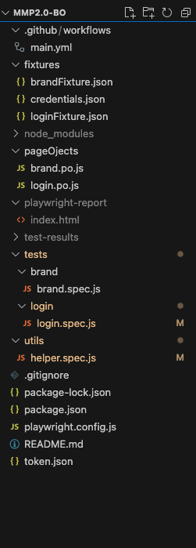
Project Structure
The playwright.config is where you can add configuration for Playwright
Package.json file contains the dependencies for the project
The tests folder contains a tests that are to be executed
Fixtures directory contains the files that are used in automated tests like test data, config files, etc
Page object contains the web elements locators that are used to trigger actions for certain event
Playwright-report folder contains the test report that are generated after the tests are completely executed
Main.yml file is the config file used to run the test in CI

Slide 12
Locating web elements > Xpath
XPath is a technique that allows you to navigate the structure of a webpage’s HTML
Using XPath helps find elements that are not found by locators such as ID, class, or name
Types of XPath
Absolute XPath
Absolute XPath is the direct way to find the element
It begins with the single forward slash(/)
Select the element from the root node
Eg : /html/body/div[1]/div/div[2]/header/div/div[2]/a
Relative XPath
Path starts from the middle of the HTML DOM structure
It starts with the double forward slash (//)
It can search the element anywhere at the webpage
Eg : //*[@id="block-perfecto-main-menu"]/div[2]/span

Slide 13
Playwright Apis
Playwright Test comes with the built-in request fixture
Request.post
Request.get
Request.patch
Request.delete
Response.status
Response.json
responseBody.{Key}

Slide 14
Thank You..!!

